Slide 1
Discussion 5 - Mutation, Nonlocal, Trees
Chris Allsman (they/them)

Slide 2


Attendance
links.cs61a.org/chris-disc
Magic Word: spruce

Slide 3
Mutation

Slide 4

Mutation
A way to change the state of our program by modifying objects
Doesn’t create a new object, just changes it somehow
E.g. adding/removing elements

Slide 5
List Mutation
Have different mutation methods
Look different, but act mostly like functions
Ex: lst.pop()
These have the side effect of mutating our list
All methods but pop return None

Slide 6
Examples
https://goo.gl/11CfU9
https://goo.gl/najrgR
https://goo.gl/CLEvBP

Slide 7
Mutation Summary
Mutates the list | Creates a list
lst[i] = x or lst[a:b] = some_lst | lst[a:b]
lst1 += lst2 | lst1 + lst2
lst.append(x) | list(lst)
lst.insert(i, x) | [x + 1 for x in lst]
lst.remove(x) | [a, b]
lst.pop(i)
lst.extend(lst)

Slide 8
Nonlocal

Slide 9
Deterministic Functions
def f(x):
return x + 1
>>> f(5)
>>> f(5)
…
>>> f(5)
Functions which always return the same value when called on the same input

Slide 10
Deterministic Functions
def f(x):
return x + 1
>>> f(5)
6
>>> f(5)
…
>>> f(5)
Functions which always return the same value when called on the same input

Slide 11
Deterministic Functions
def f(x):
return x + 1
>>> f(5)
6
>>> f(5)
6
…
>>> f(5)
6
Functions which always return the same value when called on the same input

Slide 12
Mutable Functions
Nondeterministic - can call it with the same input multiple times and output will change
Many ways to do this!
Generally work by mutating state

Slide 13
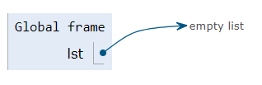
Mutating Objects
>>> foo(5)
>>> foo(5)
lst = []
def foo(x):
lst.append(x)
return sum(lst)

Slide 14
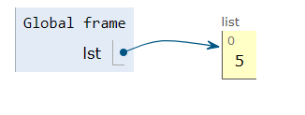
Mutating Objects
>>> foo(5)
5
>>> foo(5)
lst = []
def foo(x):
lst.append(x)
return sum(lst)

Slide 15
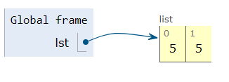
Mutating Objects
>>> foo(5)
5
>>> foo(5)
10
lst = []
def foo(x):
lst.append(x)
return sum(lst)

Slide 16
Almost Mutative...
>>> foo = foo(5)
5
>>> foo = foo(5)
10
https://goo.gl/auwdF5
def outer(x):
def inner(y):
print(x)
Return outer(x + y)
return inner
foo = outer(0)

Slide 17
Actually Mutative!
def outer(x):
def inner(y):
nonlocal x
x = x + y
return x
return inner
foo = outer(0)
>>> foo(5)
>>> foo(5)

Slide 18
Why Nonlocal?
Before, could:
Create new binding
Access binding in parent
Access binding in current frame
Modify binding in current frame
def foo():
n = 10
def inner(x):
x = x + n

Slide 19
Why Nonlocal?
Before, could:
Create new binding
Access binding in parent
Access binding in current frame
Modify binding in current frame
Now, can:
Modify binding in parent frame

Slide 20
Nonlocal Environments
Rules:
Binding must exist in non-global parent
x = 1
def bad():
nonlocal x
x += 1

Slide 21
Nonlocal Environments
Rules:
Nonlocal binding must exist in non-global parent
Nonlocal binding must not exist in current frame
def bad(x):
nonlocal x
x += 1

Slide 22
Actually Mutative!
def outer(x):
def inner(y):
nonlocal x
x = x + y
return x
return inner
foo = outer(0)
>>> foo(5)
5
>>> foo(5)
10
https://goo.gl/fXc2Aw

Slide 23
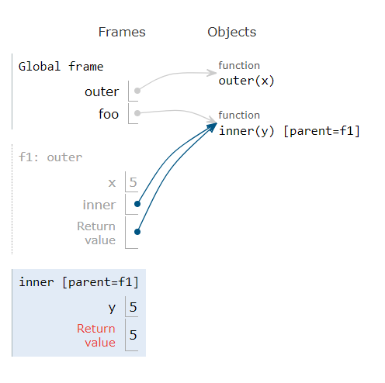
Nonlocal Environments
Rules:
Nonlocal binding must exist in non-global parent
Nonlocal binding must not exist in current frame
Do not create new bindings for variables declared nonlocal
Modify binding here

Slide 24
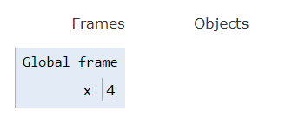

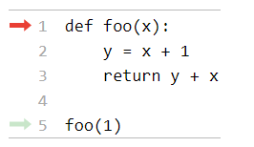
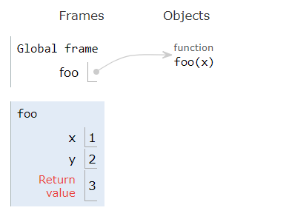
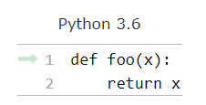
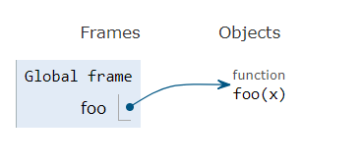
Assignment Statements:
Call Expressions:
Evaluate RHS
Make binding in current frame
Def Statements:
[P = G]
Label w/ index, name, parent
f1
[P = G]
[P = G]
Bind arguments to parameters
Don’t go into body yet
Make binding in current frame
Return something

